Slide 1
Question 2
GROUP MEMBERS:
CHELESE HINDS 1700262941
DAVID CHUNG 1700263258
ELSHAUNA DIXON 1700217399
MARJORIE SINCLAIR 1700253686
WAKAR MOLAR 1700235744

Slide 2
The Key Features of Static RAM
The data is held statically: data is held in a semiconductor memory without the need to be refreshed as long as there is power.
SRAM memory is a form of random access memory: A random access memory is one in which the locations in the semiconductor memory can be written to or read from in any order, regardless of the last memory location that was accessed.

Slide 3
Steps in Cache Organization
Direct Mapping The simplest technique, known as direct mapping, maps each block of main memory into only one possible cache line. In Direct mapping, assign each memory block to a specific line in the cache. If a line is previously taken up by a memory block when a new block needs to be loaded, the old block is trashed. An address space is split into two parts index field and a tag field. The cache is used to store the tag field whereas the rest is stored in the main memory.

Slide 4
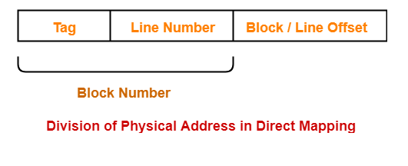
Diagram showing Division of Physical Address in Direct Mapping

Slide 5
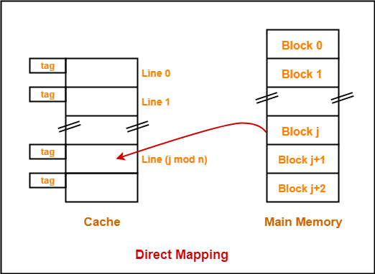
Implementation of Direct Mapping

Slide 6
Steps in Cache Organization cont.
Associative Mapping In this type of mapping, the associative memory is used to store content and addresses of the memory word. Any block can go into any line of the cache. This means that the word id bits are used to identify which word in the block is needed, but the tag becomes all of the remaining bits. This enables the placement of any word at any place in the cache memory. It is considered to be the fastest and the most flexible mapping form

Slide 7
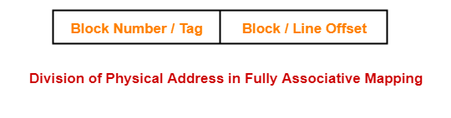
Diagram showing Division of Physical Address in Fully Associative Mapping

Slide 8
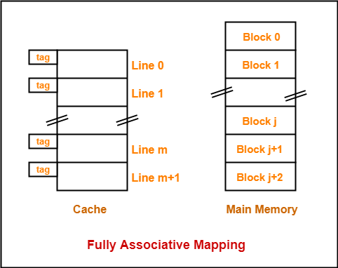
Implementation of Fully Associative Mapping

Slide 9
Steps in Cache Organization cont.
Set-associative Mapping
An enhanced form of direct mapping where the drawbacks of direct mapping are removed.
Addresses the problem of possible thrashing in the direct mapping method

Slide 10
Steps in Cache Organization cont.
In k-way set associative mapping
Cache lines are grouped into sets where each set contains k number of lines.
A particular block of main memory can map to only one particular set of the cache.
However, within that set, the memory block can map to any freely available cache line.

Slide 11
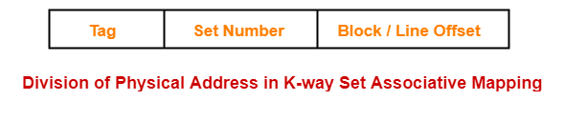
Diagram showing Division of Physical Address in K-way Set Associative Mapping

Slide 12
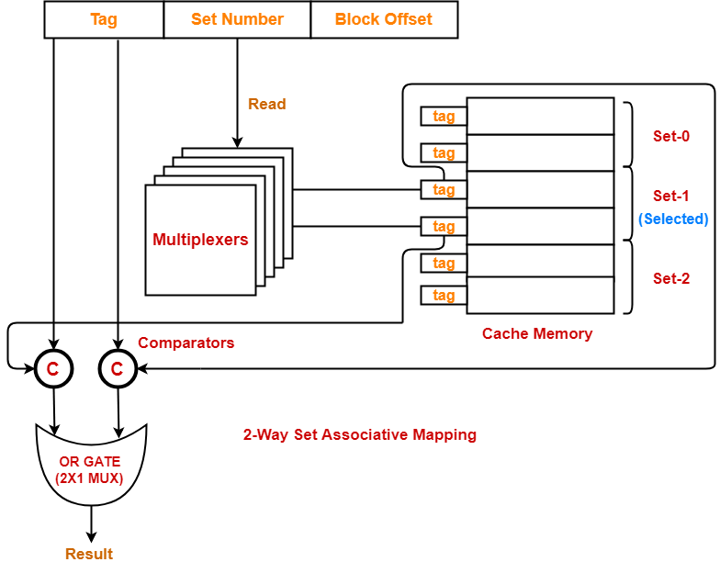
Implementation of 2-way Set Associative Mapping

Slide 13
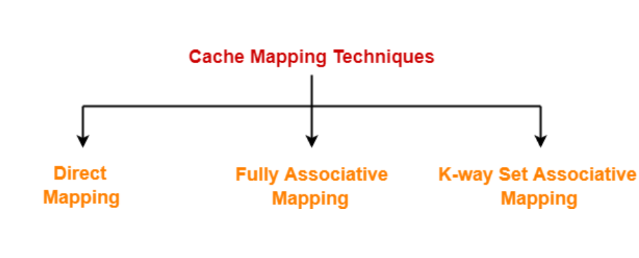
REPRESENTATION OF CACHE MAPPING TECHNIQUES

Slide 14
Features of Memory Register
Memory Address Register (MAR) is a CPU register that either stores the memory address from which data will be fetched to the CPU or the address to which data will be sent and stored. In other words, MAR holds the memory location of data that needs to be accessed.
Memory Data Register (MDR) A register used for holding information (either program words or data words) that is in the process of being transferred from the memory to the central processor, or vice versa.

Slide 15
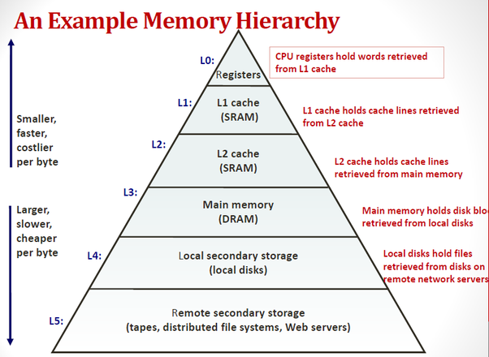
A Representation Cache Memory Hierarchy.

Slide 16
Importance of Direct mapping and Set Associative mechanisms for organizing cache
Direct Mapping
Simple
Easily Implemented
Set Associative Mapping
Enhanced Direct Mapping
Address the problem of thrashing

Slide 17
References
https://www.gatevidyalay.com/set associative-mapping-cache-mapping/
https://www.geeksforgeeks.org/cache-memory-in-computer-organization/
https://www.gatevidyalay.com/cache-mapping-cache-mapping-techniques/
https://www.gatevidyalay.com/set-associative-mapping-cache-mapping/

Slide 18
References cont.
https://www.encyclopedia.com/computing/dictionaries-thesauruses-pictures-and-press-releases/memory-data-register
https://en.wikipedia.org/wiki/Memory_address_register
https://www.electronics-notes.com/articles/electronic_components/semiconductor-ic-memory/static-ram-sram.php

